Slide 1
A new Henry George Theorem for NZ’s urban policy needs
Chris Parker
NZAE Conference 2022
NOT TREASURY POLICY
29 June 2022

Slide 2
The benefits of cities
Result: New Henry George Theorem:
New: Differential land rents equal the value of local public goods and wage premiums less local government expenditure
Old: Differential land rents equal the cost of local public goods
Use to redesign urban institutions to create virtuous cycles
Discovery/appraisal, funding, finance, incentives etc
Key to reconciling with competitive urban land markets

Slide 3
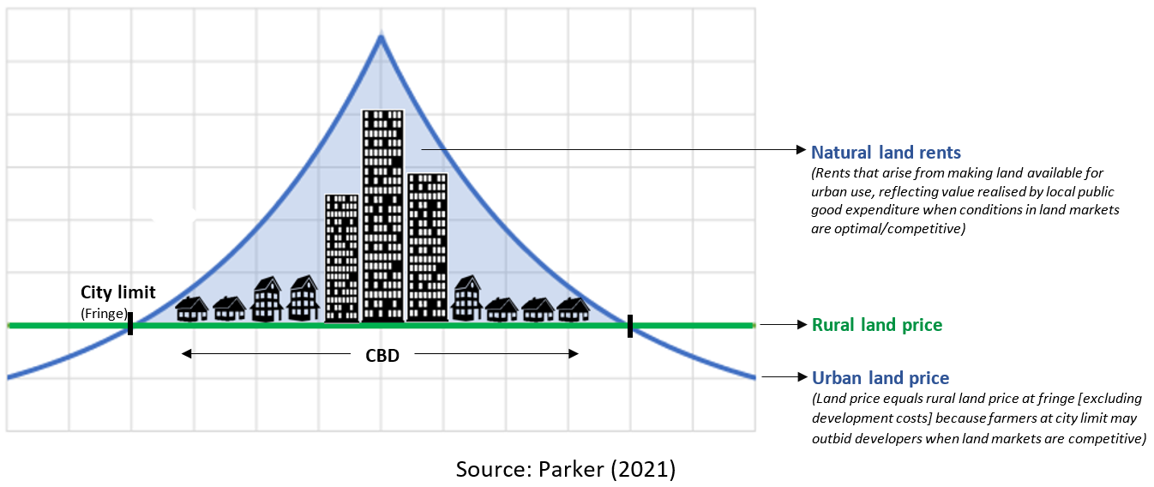
Traditional city model
Differential land rents (DLR)
Opportunity rents
(Rents based on the willingness to pay from the best forgone non-urban opportunity)
360º

Slide 4
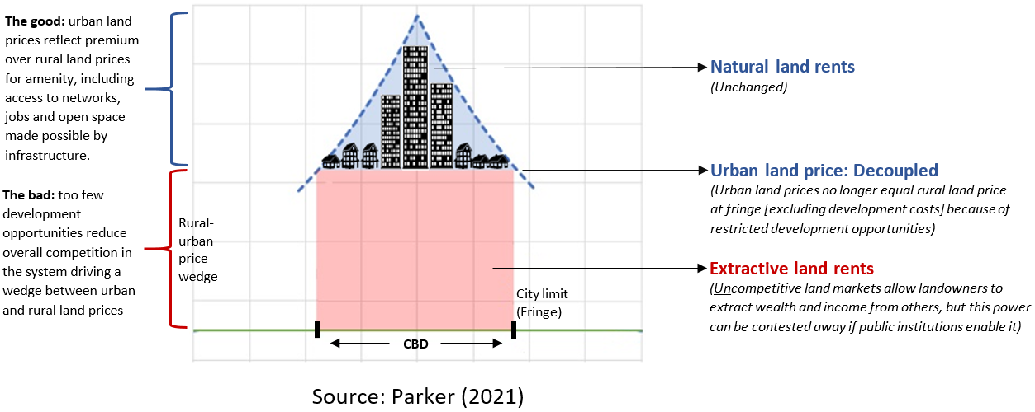
Uncompetitive urban land markets
Differential land rents (DLR)
Extractive land rents (ELR)
Opportunity rents
(Rents based on the willingness to pay from the best forgone non-urban opportunity)
360º
“Uncompetitive” not because of monopoly, but because contestable economic rents are being sustained

Slide 5
Arnott & Stiglitz 1979 and 1981 These underpin modern land tax, urban economics & policy, urban transport appraisal

Slide 6
Arnott and Stiglitz (1979) Main model set-up
Utility maximising households $U(T,C,P)$
Individuals in a city are identical and have a utility function $U(T,C,P)$ for land consumption $T$ in m², consumption of general goods $C$, and consumption of public good $P=eE$, where governments expend $E$ and have efficiency $e$ converting inputs to outputs
Budget constrained $R\left(t\right)T(t)+C+f\left(t\right)=I$
Where $R\left(t\right)$ is the m² price to rent land and $f(t)$ the cost to travel at distance $t$ from the city centre, and $I$ is income
Spatial, but planned city out of spatial equilibrium
$φ(t)$ is the shape of the city, which for a circular city $φ\left(t\right)=2πt$, the circumference of ‘a ring’, & $\overline{t}$ is the distance to the urban fringe
Social planner directs population size & location

Slide 7
Arnott and Stiglitz (1979) Henry George Theorem
Derived a HGT, that $DLR=Expenditure$
The value of differential land rents ($DLR$) — the blue triangle — equals the expenditure ($E$) on a pure local public good in a city of optimal population size
The problem is, DLR not a function of public good consumption $P!$ What if efficiency was zero, so all expenditure is wasted? Surely DLR would shrink as people left?

Slide 8
Arnott and Stiglitz (1981) ‘Rents & transport costs’
In a closed (fixed-population) city
“Since aggregate land rents may, in general, rise, remain the same, or fall in response to a transport improvement, the induced change in aggregate land rents by itself is, except under conditions very unlikely to be satisfied, an incorrect measure of benefits from the transport improvement”
But in an open city model we can use the HGT. We will show there is a relationship between land rents and social benefits

Slide 9
Arnott & Stiglitz 1979, open city & fiscal packages
Stopped short of deriving a HGT for the open city
Indirect utility function in cross-city spatial equilibrium
$$V\left(R\left(t\right)\left(1+τ\right),I−f\left(t\right),P,A\right)=\overline{U}$$
Local government supplies public goods
$P=eE$, output equals efficiency times expenditure
They tax land with budget constraint: $τDLR=E$
Their result
$$\frac{∂DLR}{∂e}=E\int_{0}^{\overline{t}}{\frac{V_{P}}{V_{Y}}\frac{φ}{T}dt}$$
More efficiency increases DLR in proportion to expenditure and value. Population and tax rates adjust

Slide 10
Adaption of Arnott & Stiglitz 1979

Slide 11
Deriving a HGT for the open city
We can expression for expenditure
$$\frac{∂DLR}{∂E}=e\int_{0}^{\overline{t}}{\frac{V_{P}}{V_{Y}}\frac{φ}{T}dt}−1$$
DLR increases with expenditure if the BCR ≥ 1

Slide 12
Deriving a HGT for the open city
We jointly integrate $\frac{∂DLR}{∂e}$ and $\frac{∂DLR}{∂E}$ to recover DLR, holding population, land use, and land rents fixed—out of equilibrium—to determine willingness to pay
$$DLR(e,E,W,A)= \int_{0}^{\overline{t}}{\frac{V(R,Y,P,A)}{V_{Y}}\frac{φ}{T}dt}−E$$
In words: The value of differential land rents ($DLR$) — the blue triangle — equals the value of pure local public goods both government-supplied ($P$) and exogenous ($A$) and city wage premium ($W$) in a city with flexible population, less the cost of government supply ($E$) when funded from a local land tax with a balanced budget

Slide 13
Insights
More scale economies increase DLR
Increase infrastructure capacity, public goods, productivity, and housing supply
Diseconomies of scale decrease DLR
Congestion and crowding reduce city benefits and DLR
Better local government performance increases DLR
Increased efficiency in public good provision, optimal expenditure, optimal regulation of amenity and externalities, pro-growth zoning policy, pro-growth infrastructure planning and supply
Can define municipal local governments to be vehicles to maximise DLR
Can update cost-benefit analysis (CBA) for local infrastructure and planning

Slide 14
Some limitations
Assumes cities are numerous and no one city affects national prices, utility
Will not hold if extractive land rents increase much faster than people can relocate (people are priced out vs priced in)
It is not a theory of the absolute value/utility of cities, transport etc
So A&S 1981’s quote about the ambiguity of land rents and transport is relevant for universal transport cost changes (such as technological revolutions) that don’t cause people to relocate

Slide 15
Next steps
Release a paper this year
Develop general open-city model of uncompetitive urban land markets
Inform reforms of CBA and funding and financing practices for urban infrastructure and development
ENDS

